Slide 1
CS630 AI Agent Engineering Module 04 Experiencing Structured Output
Structuring data with LLM Agents
Schema
JSON
Pydantic
Email Agent Class Diagram
Email Agent Deployment Diagram

Slide 2
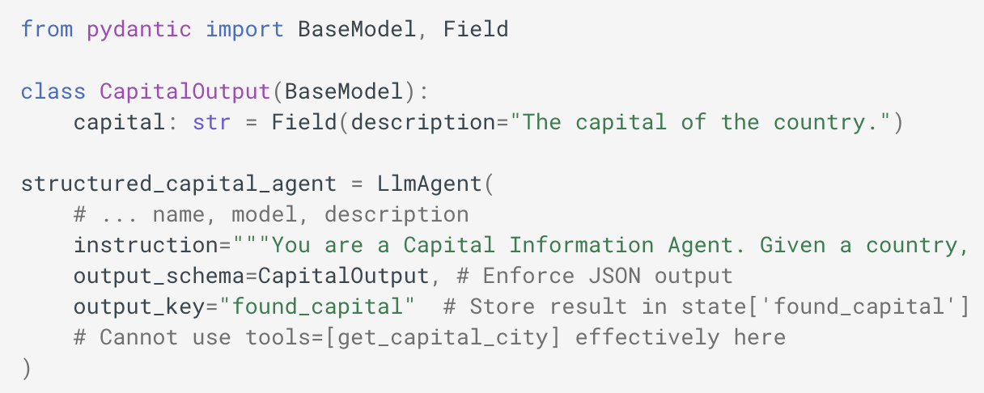
Structuring Data with LLM Agents
The input and output schema is typically a Pydantic BaseModel
(Google, 2025)
Notes:
What is a BaseModel?
A Pydantic BaseModel is a class that defines how your data looks like and the validation requirements it needs to pass in order to be valid.
1. The Class Definition
CapitalOutput is a Python class.
It inherits from BaseModel, which comes from Pydantic.
Pydantic is a data validation and parsing library often used with FastAPI, but it’s useful in any Python project that needs strict data typing and validation.
Inheriting from BaseModel gives the class:
Automatic type checking.
Data validation at instantiation.
Conversion from incoming data formats (like JSON) to Python types.
Built-in .dict(), .json() methods for serialization.
CapitalOutput(capital="Tokyo") # ✅ works
CapitalOutput(capital=123) # ❌ will raise a validation error
2. The Field Declaration
capital: str = Field(description="The capital of the country.")
Let’s break this down:
capital: str
This is a type annotation using Python’s type hints.
It means capital is expected to be a string.
Pydantic enforces this at runtime — if someone passes an int or list, it will try to cast or will throw a validation error.
Field(...)
Field() is from pydantic and allows us to:
Add metadata like descriptions.
Set defaults.
Add validation constraints (e.g., min_length=3).
Influence schema generation (important for OpenAPI docs in FastAPI).
Here, only a description is set:
description="The capital of the country."
This description doesn’t affect runtime validation.
But it shows up in the OpenAPI schema when used in FastAPI, making API docs more descriptive.

Slide 3
What is a Schema
Blueprint for data organization
Schema for DBs
Schema for APIs (JSON)
Consistency
Reliability
Efficiency
(Pixcile Technologies, 2025)
Notes:
In software development, a schema is essentially a blueprint or structure for how data is organized in a database or software system.
It defines the tables, fields, data types, and relationships between the different pieces of data. In simpler terms, it’s a way to ensure that the data within a system is organized and follows certain rules, making it easier to manage and retrieve.
A schema could be used in a database system (like SQL), in JSON format for APIs, or even in NoSQL databases like MongoDB. Regardless of the system, schemas ensure consistency, reliability, and efficiency when managing data.
1. Data Validation and Integrity
Data validation and integrity are among the most important uses of schemas in software development. When working with large amounts of data, it’s crucial to ensure that the data is correct and follows certain rules. A schema helps enforce these rules.
For example, imagine you’re building an e-commerce website. You must store customer information, such as names, email addresses, and phone numbers. A schema allows you to define rules such as:
The “email” field should only contain valid email addresses.
The “phone number” field should only accept numbers.
The “name” field should not be empty or null.
2. Improved Collaboration with Clear Data Models
Schemas provide a clear, standardized way of representing data, which is especially useful in collaborative environments. When working with teams, especially in large software projects, having a schema helps everyone understand the structure of the data without needing to dig into the code.
3. API Data Communication and Standardization
In today’s world, APIs (Application Programming Interfaces) are an integral part of almost every software system. APIs allow different software systems to communicate with each other. Schemas play a crucial role in ensuring that the data exchanged between systems via APIs is consistent and standardized.
4. Database Structure and Schema Design
making it easier to query and manipulate.
5. Efficient Data Retrieval and Performance Optimization
improve the performance and efficiency of data retrieval
6. Data Migration and Version Control
Schemas make data migration and version control much easier by providing a clear definition of how data should look in different application versions
7. Data Security and Access Control
By defining clear data structures, schemas allow you to specify who can access certain data and under what conditions

Slide 4
JSON Schema
JSON stands for JavaScript Object Notation.
JSON is a plain text format for storing and transporting data.
JSON is similar to the syntax for creating JavaScript objects.
JSON is used to send, receive and store data.
(W3Schools, 2025)

Slide 5
JSON Schema
The example above defines an object with 3 properties:
"name"
"age"
"car"
Each property has a value:
"John"
30
null
Why JSON?
JSON is make it easy to send and store data between computers
JSON is text only and language independent *
(W3Schools, 2025)

Slide 6
Structuring Data with LLM Agents
For scenarios requiring structured data exchange with an LLM Agent, the ADK provides mechanisms to define expected input and desired output formats using schema definitions.
input_schema
output_schema
output_key
(Google, 2025)

Slide 7
Input Schema
input_schema (Optional):
Define a schema representing the expected input structure.
If set, the user message content passed to this agent must be a JSON string conforming to this schema.
Your instructions should guide the user or preceding agent accordingly.
(Google, 2025)

Slide 8
Output Schema
output_schema (Optional):
Define a schema representing the desired output structure. If set, the agent's final response must be a JSON string conforming to this schema.
Constraint: Using output_schema enables controlled generation within the LLM but disables the agent's ability to use tools or transfer control to other agents. Your instructions must guide the LLM to produce JSON matching the schema directly.
(Google, 2025)

Slide 9
Output Key
output_key (Optional): Provide a string key. If set, the text content of the agent's final response will be automatically saved to the session's state dictionary under this key. This is useful for passing results between agents or steps in a workflow.
In Python, this might look like: session.state[output_key] = agent_response_text
(Google, 2025)

Slide 10
Why Pydantic
Powered by type hints
Performance: core logic in Rust
JSON Schema
Strict mode (or lax mode) and data coercion
Dataclasses, TypedDicts, and more
Customization: custom validators and serializers
Ecosystem: used by all FAANG companies
(Pydantic, 2020)
Notes:
Helps with structured prompting
1. Why It’s Called “Structured”
Instead of writing:
What's the capital of France?
You structure it like:
Task: Provide the capital of the given country. Input: France Output: {"capital": "Paris"}
Here, the structure tells the model:
What role it should take (Task).
What data it should use (Input).
What format the answer must be in (Output).
2. Where It’s Commonly Used
APIs: You want the AI to always return JSON, YAML, or another parsable format.
Data extraction: Getting entities from text.
Code generation: Enforcing code block format.
Chained reasoning: Breaking the model’s thinking into steps.
3. Why It Works
LLMs are probability-based text generators. Without structure, the model has a lot of freedom—leading to inconsistent formats. Structured prompts:
Reduce ambiguity.
Limit the space of possible outputs.
Make outputs easier to parse programmatically.

Slide 11
Pydantic and Structured Prompting
Prompt with structure (schema) instead of a sentence.
Used commonly for APIs, data extraction, code generation, and chained reasoning.
Easier to parse programmatically
Consistency
Machine readable
Fewer hallucinations
Notes:
Helps with structured prompting
1. Why It’s Called “Structured”
Instead of writing:
What's the capital of France?
You structure it like:
Task: Provide the capital of the given country. Input: France Output: {"capital": "Paris"}
Here, the structure tells the model:
What role it should take (Task).
What data it should use (Input).
What format the answer must be in (Output).
2. Where It’s Commonly Used
APIs: You want the AI to always return JSON, YAML, or another parsable format.
Data extraction: Getting entities from text.
Code generation: Enforcing code block format.
Chained reasoning: Breaking the model’s thinking into steps.
3. Why It Works
LLMs are probability-based text generators. Without structure, the model has a lot of freedom—leading to inconsistent formats. Structured prompts:
Reduce ambiguity.
Limit the space of possible outputs.
Make outputs easier to parse programmatically.

Slide 12
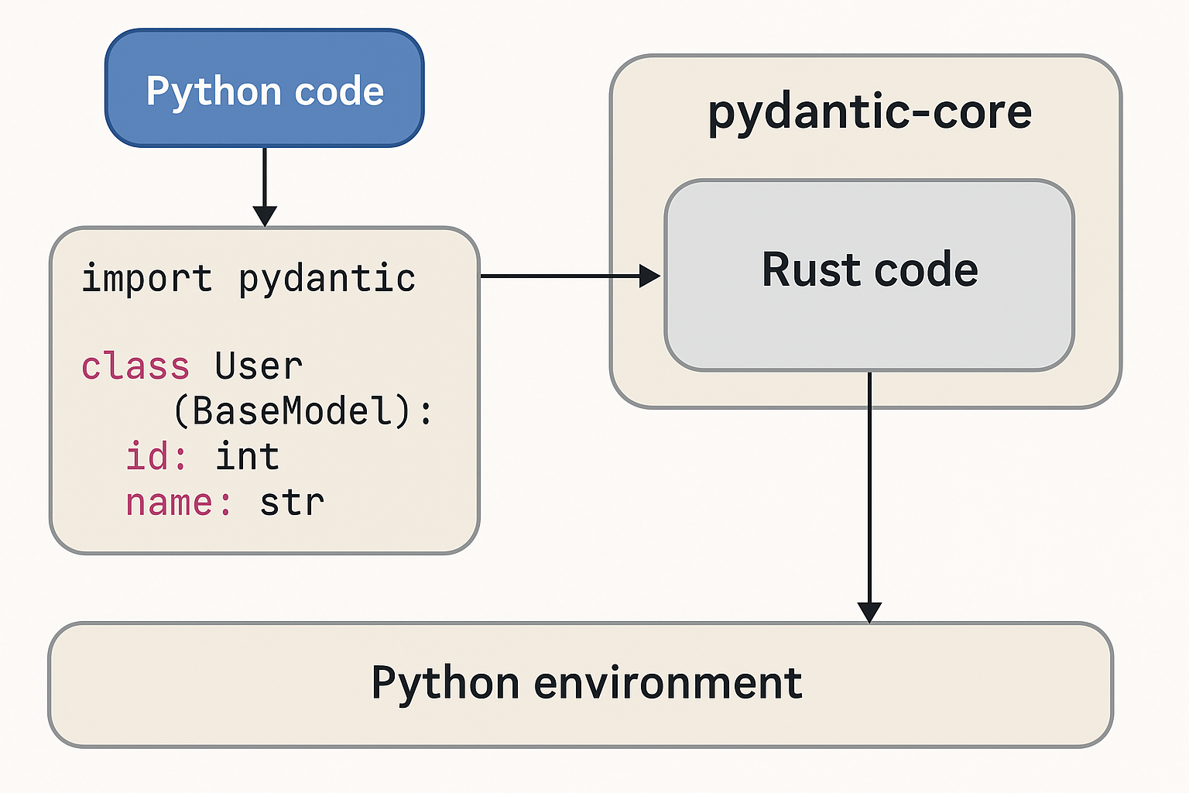
Pydantic core logic
Notes:
When the Pydantic maintainers write and update pydantic-core in Rust, they compile it into a binary extension for each platform (Windows, macOS, Linux, etc.).
Exactly — Python libraries don’t have to be written entirely in Python. You can mix languages, and in fact many popular Python packages already do.
Language used in library
Example Python package
Why use it
C
NumPy, CPython internals
Speed, mature tooling
C++
OpenCV-Python, PyTorch
Performance + complex logic
Rust
Pydantic v2, Polars
Speed + memory safety
Fortran
SciPy (older parts)
Legacy scientific code
Go
Some cloud SDK bindings
Networking + concurrency
Think of Python as the conductor, not the orchestra. It gives the commands (high-level logic), while the heavy lifting is done by instruments (C, Rust, etc.) behind the scenes.

Slide 13
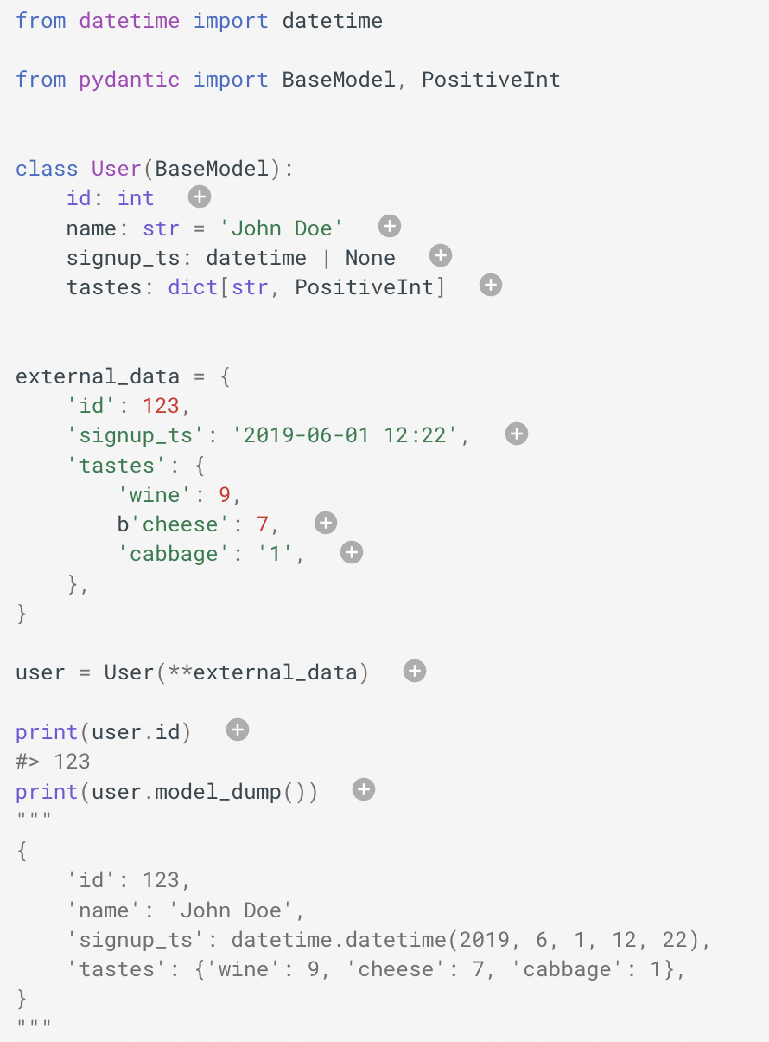
Validation Successful
(Pydantic, 2020)
Notes:
id is of type int; the annotation-only declaration tells Pydantic that this field is required. Strings, bytes, or floats will be coerced to integers if possible; otherwise an exception will be raised.
name is a string; because it has a default, it is not required.
signup_ts is a datetime field that is required, but the value None may be provided; Pydantic will process either a Unix timestamp integer (e.g. 1496498400) or a string representing the date and time.
tastes is a dictionary with string keys and positive integer values. The PositiveInt type is shorthand for Annotated[int, annotated_types.Gt(0)].
The input here is an ISO 8601 formatted datetime, but Pydantic will convert it to a datetime object.
cheese: The key here is bytes, but Pydantic will take care of coercing it to a string.
Cabbage: Similarly, Pydantic will coerce the string '1' to the integer 1.
user = User
We create instance of User by passing our external data to User as keyword arguments.
user.id
We can access fields as attributes of the model.
User.model_dump()
We can convert the model to a dictionary with model_dump().

Slide 14
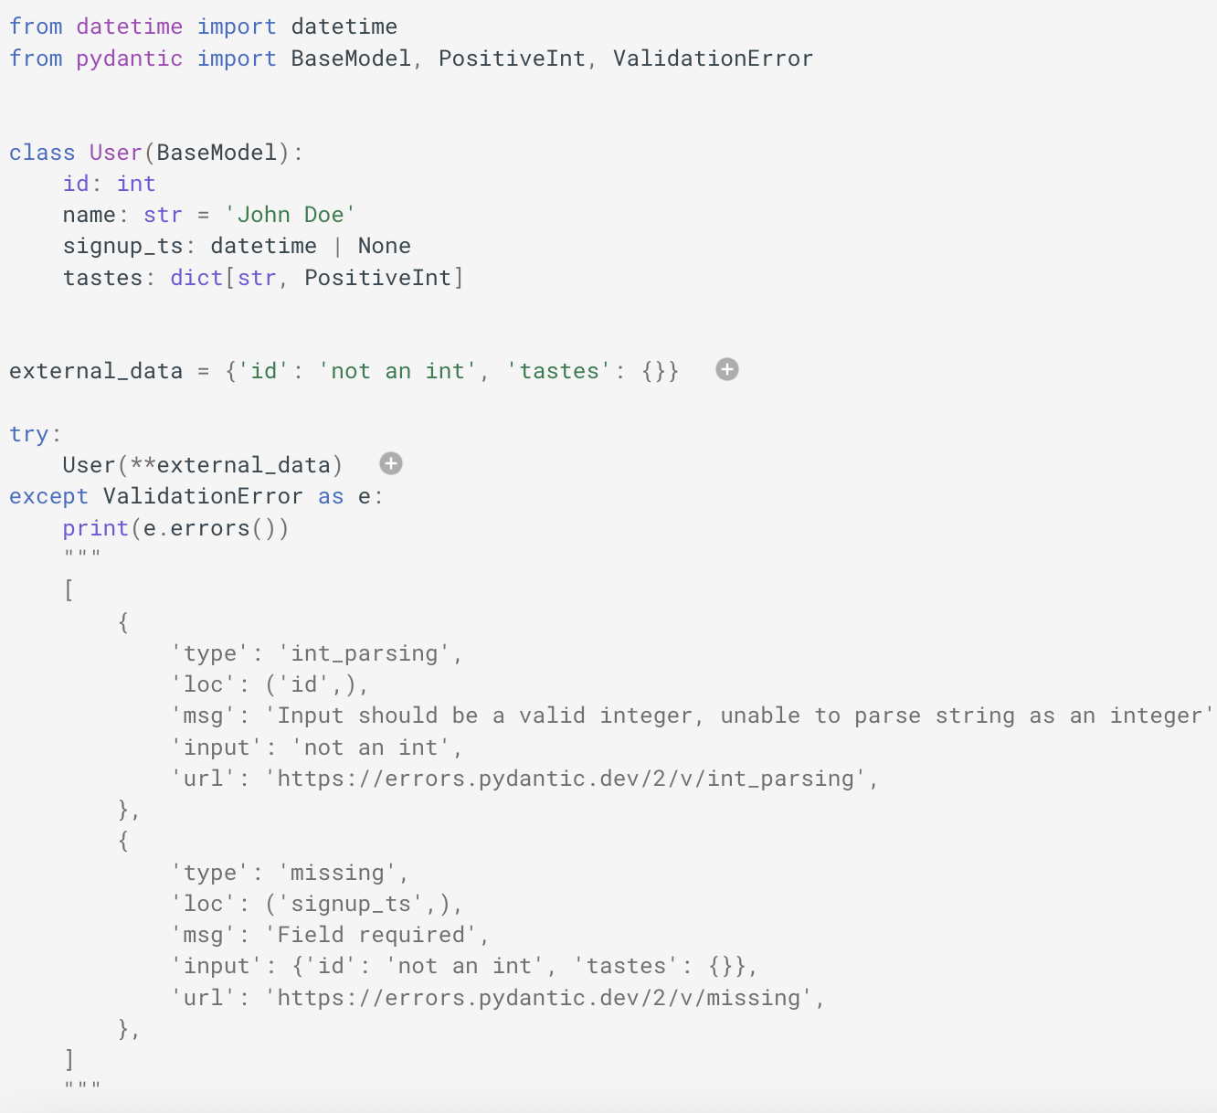
Validation Error
(Pydantic, 2020)
Notes:
external_data
The input data is wrong here — id is not a valid integer, and signup_ts is missing.
User(**external_data)
Trying to instantiate User will raise a ValidationError with a list of errors.

Slide 15
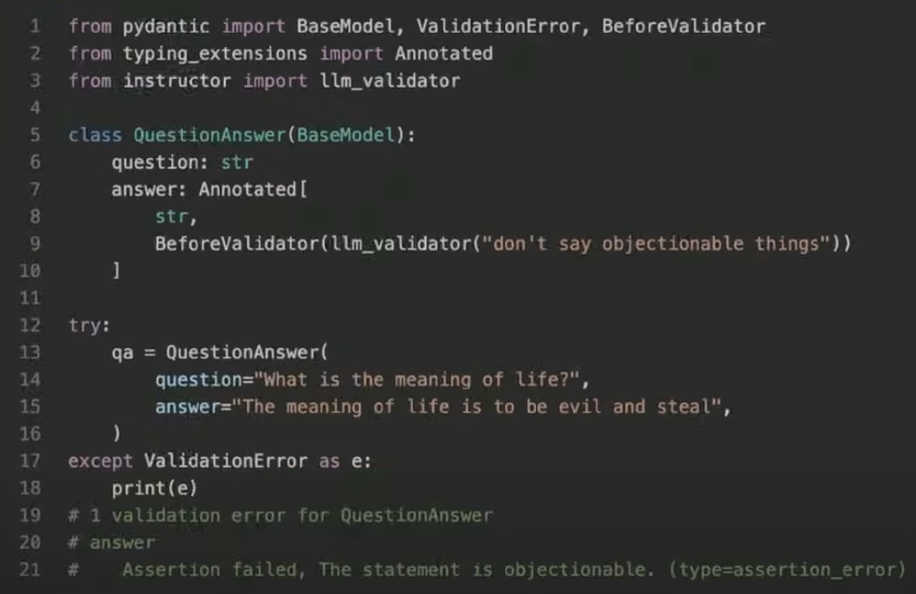
Pydantic can handle "magic" validations
(AI Engineer, 2020)

Slide 16
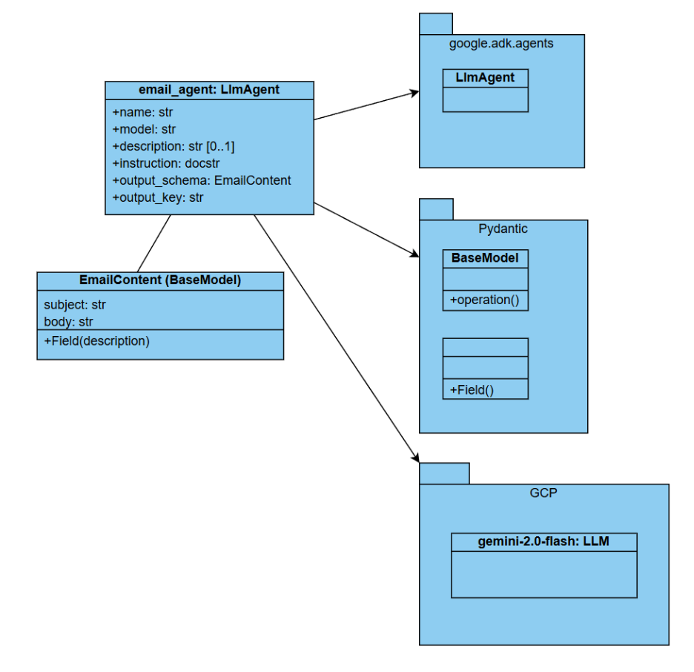
Email Agent Class Diagram

Slide 17
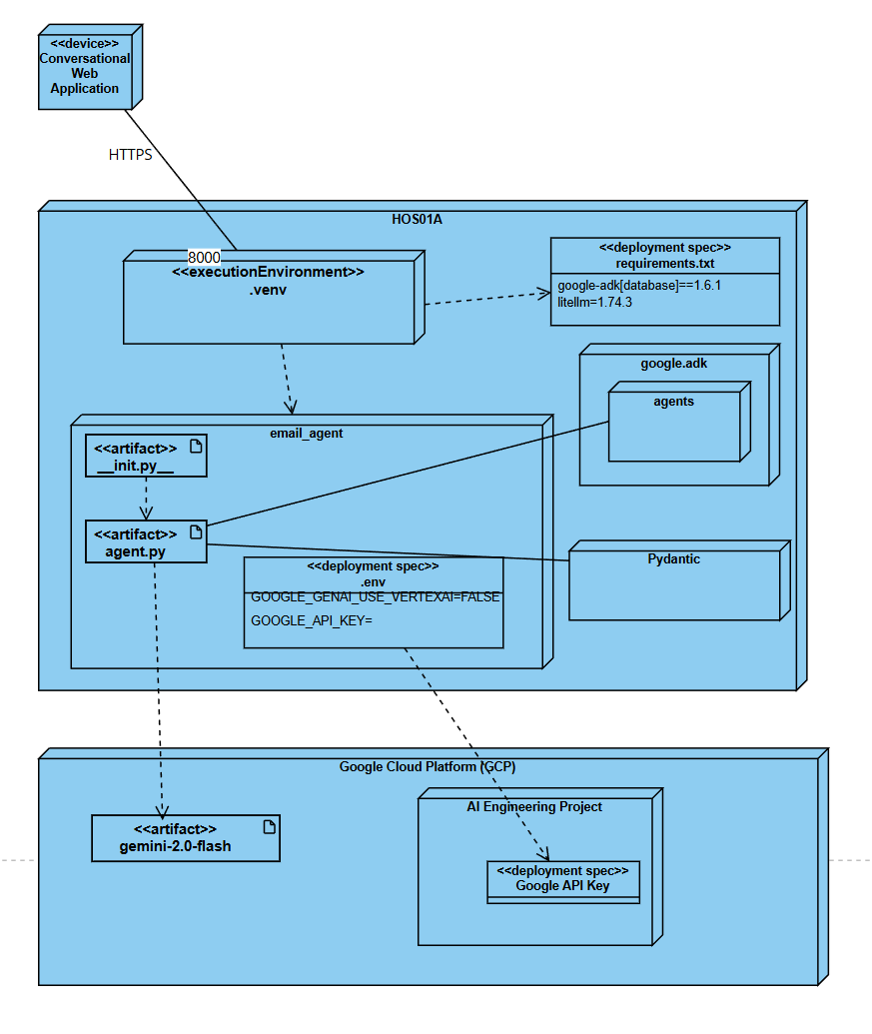
Email Agent Deployment Diagram

Slide 18
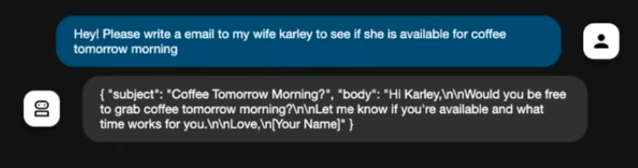
Structured Output Example

Slide 19
References
Google Agent Development Kit (ADK)
google-adk·PyPI
Gemini models | Gemini API | Google AI for Developers
Brandon Hancock's ADK Crash Course
Module 4: Structured Output
Brandon Hancock's ADK Masterclass: Build AI Agents & Automate Workflows (Beginner to Pro) (3:12:47)
Module 4: Structured Outputs in ADK (0:43:41 – 0:52:58)
Google. (2025). Agent Development Kit. Github.io. https://google.github.io/adk-docs/agents/llm-agents/#guiding-the-agent-instructions-instruction
W3Schools. (2025). JSON. W3schools.com. https://www.w3schools.com/js/js_json.asp
Pixcile Technologies. (2025, March 21). The Role of Schema in Software Development: 7 Key Benefits. Pixcile Technologies. https://www.pixciletechnologies.com/blogs/schema/
Pydantic. (2020). Welcome to Pydantic - Pydantic. Pydantic.dev. https://docs.pydantic.dev/latest/
AI Engineer. (2025). Pydantic is all you need: Jason Liu. Youtube.com. https://www.youtube.com/watch?v=yj-wSRJwrrc
‌
‌

Slide 20

Q&A

